Slide 1



Statistical Analysis and Learning (SAL): (ISL Linear Model Selection & Regularization, Ch6, part 2) Textbook: An Introduction to Statistical Learning (ISL)
Varun Rai
LBJ School of Public Affairs
The University of Texas at Austin
28th March 2018

Slide 2
Note on Material
Unless otherwise noted, all material in this presentation are from this course’s textbook, An Introduction to Statistical Learning (ISL)

Slide 3
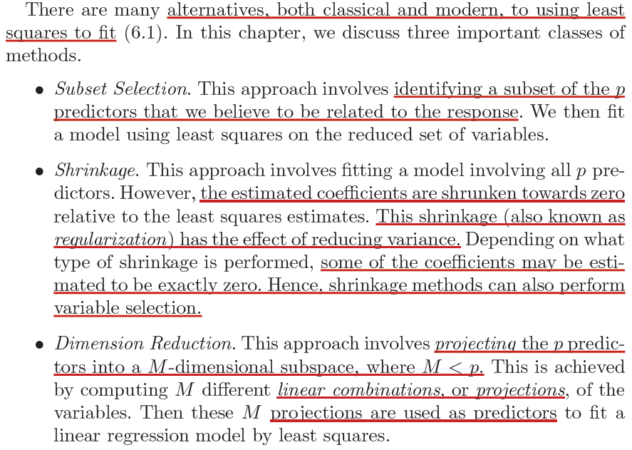
Alternatives to Least Squares Fit

Slide 4
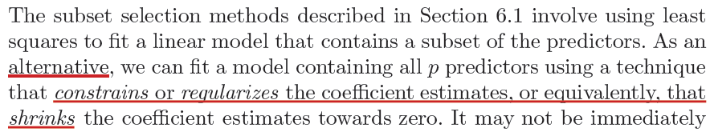
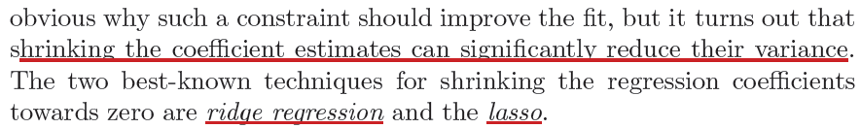
Shrinkage Methods

Slide 5
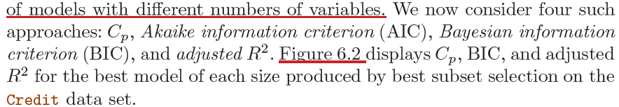

Slide 6
Dimension Reduction Methods

Slide 7
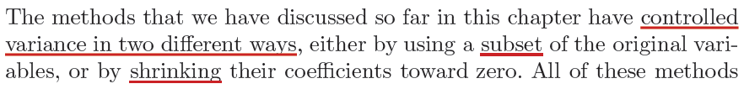
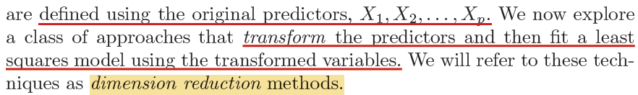
Dimension Reduction Methods

Slide 8
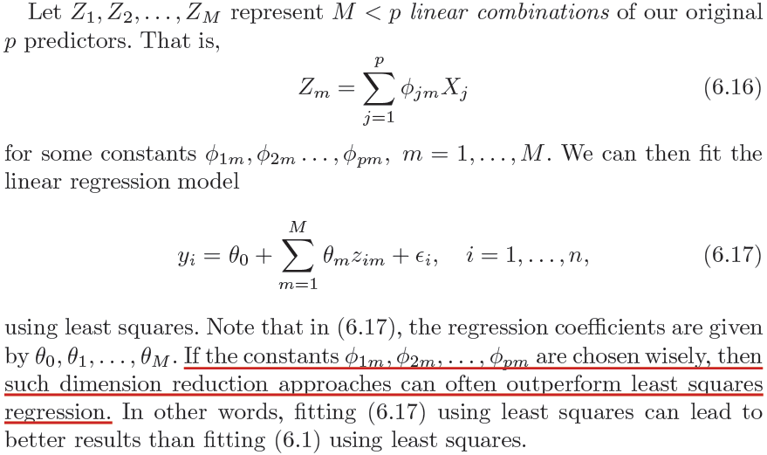
Dimension Reduction Methods

Slide 9
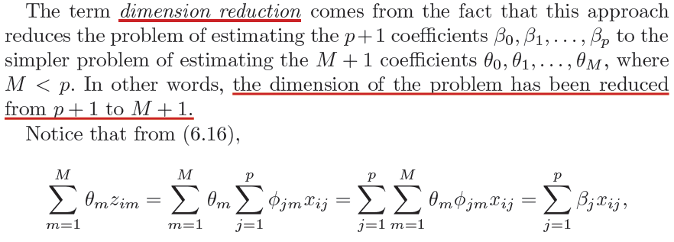
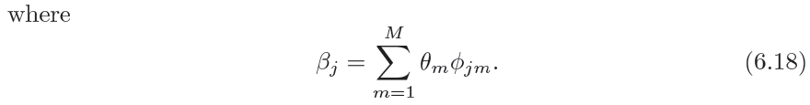
Dimension Reduction Methods

Slide 10
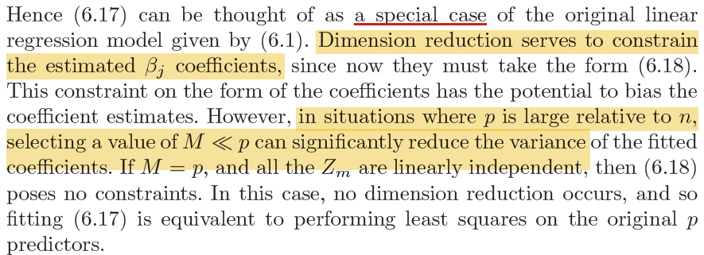
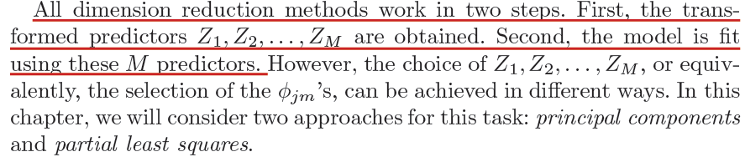
Dimension Reduction Methods

Slide 11
Principal Components Regression (PCR)

Slide 12
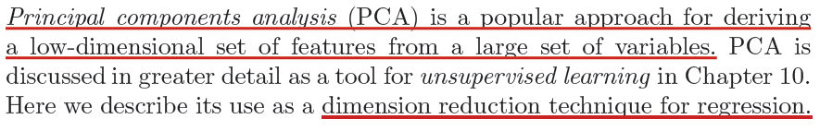
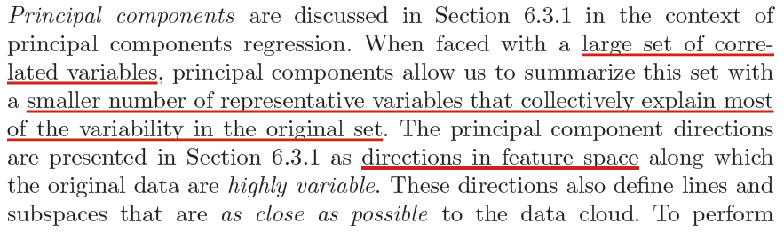
Principal Component Analysis

Slide 13
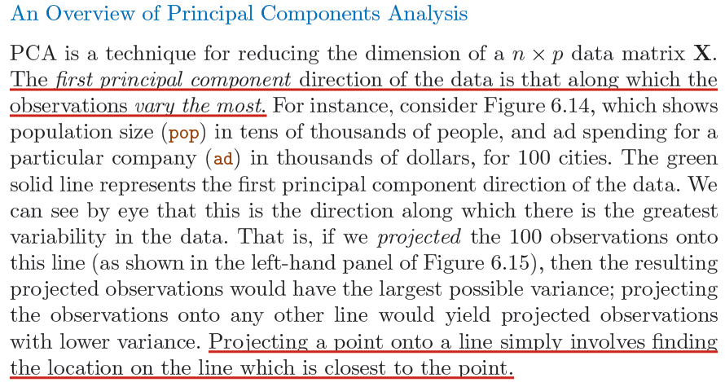
Principal Component Analysis, An Overview

Slide 14
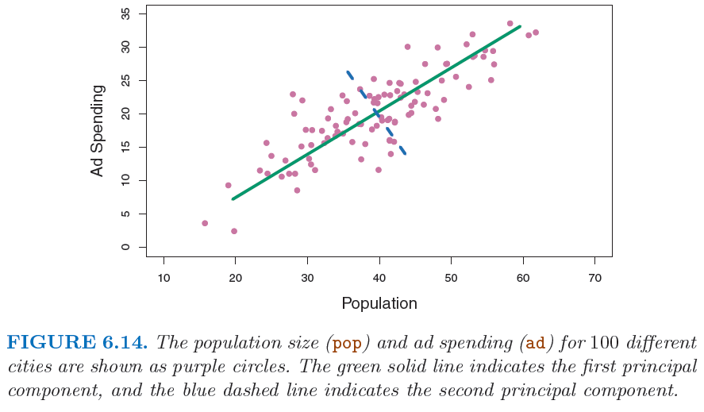
Principal Component Analysis

Slide 15

Principal Component Analysis
Notes:
For more fun, try:
http://setosa.io/ev/principal-component-analysis/

Slide 16
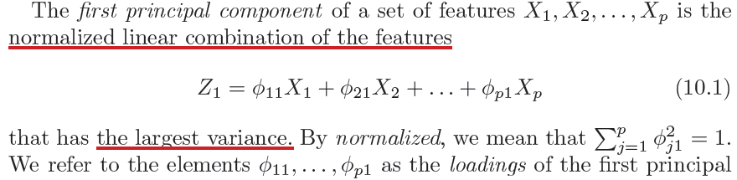
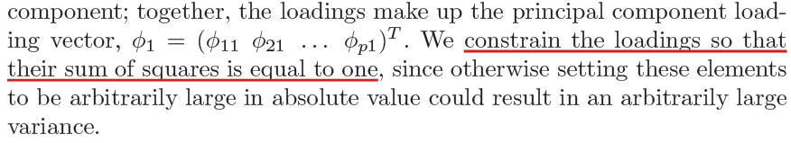
What are Principal Components?

Slide 17
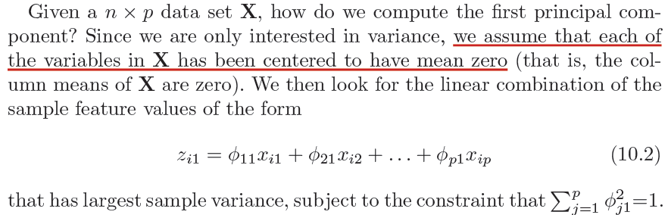
What are Principal Components?
loadings (first PC)
First principal component scores

Slide 18
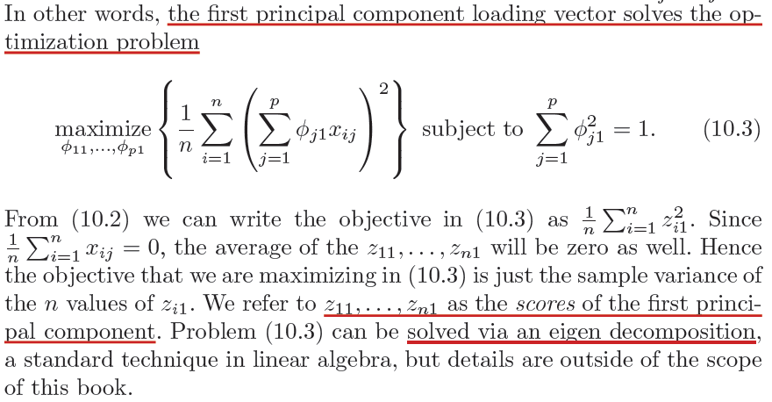
What are Principal Components?

Slide 19
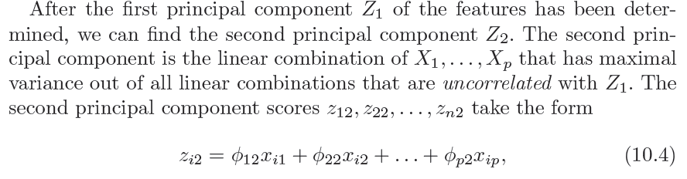
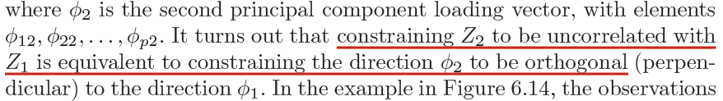
What are Principal Components?
loadings (second PC)
second principal component scores

Slide 20
Principal Component Analysis

Slide 21
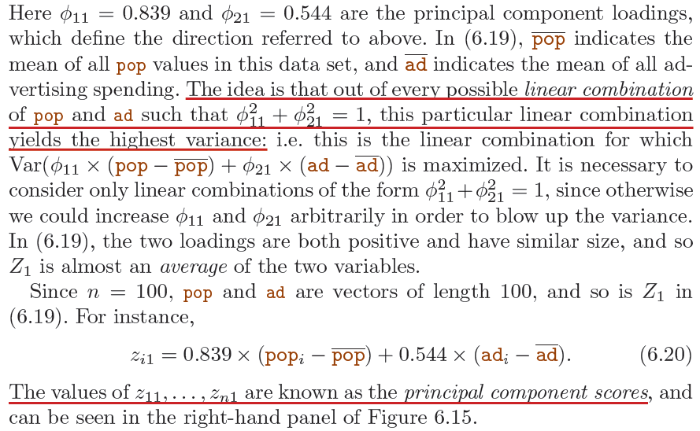
Principal Component Analysis

Slide 22
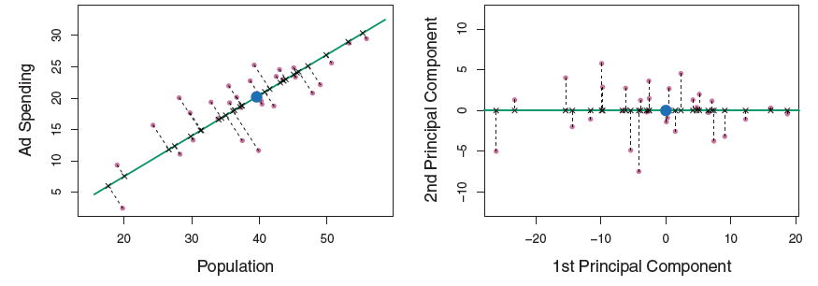
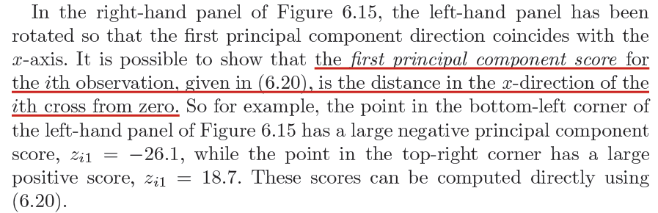
Principal Component Analysis

Slide 23
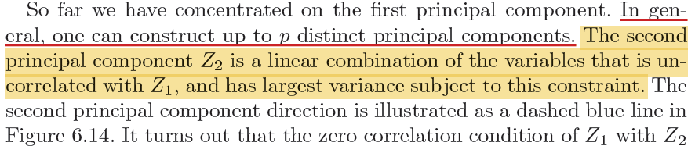
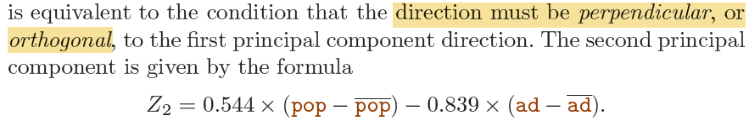
PCA, Beyond the First Principal Component

Slide 24
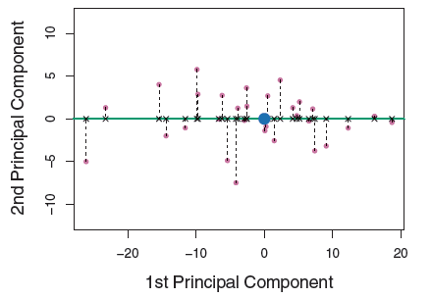
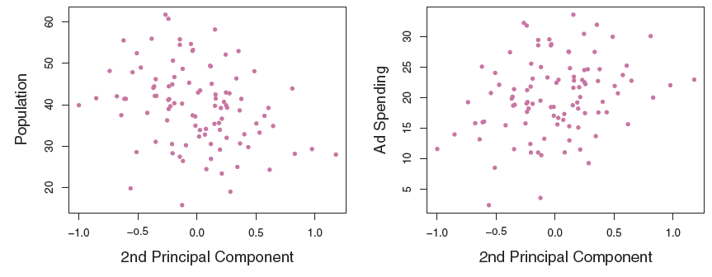
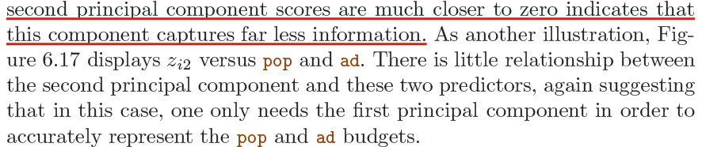
PCA, Beyond the First Principal Component

Slide 25
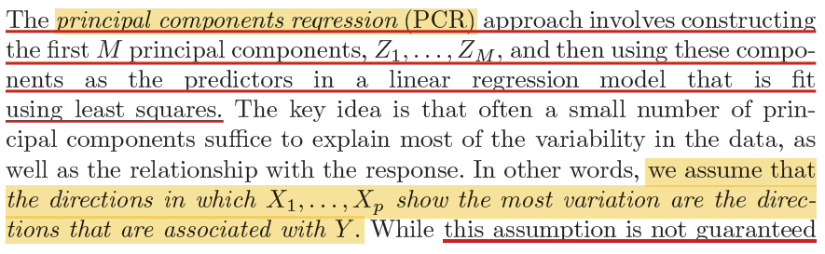
Principal Component Regression (PCR)

Slide 26
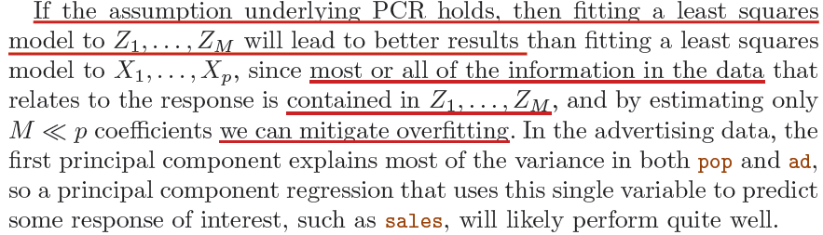
Principal Component Regression (PCR)

Slide 27
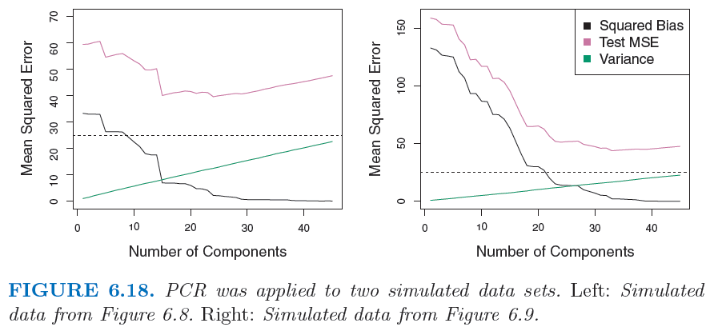
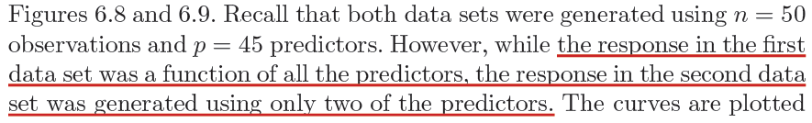
Principal Component Regression (PCR)

Slide 28
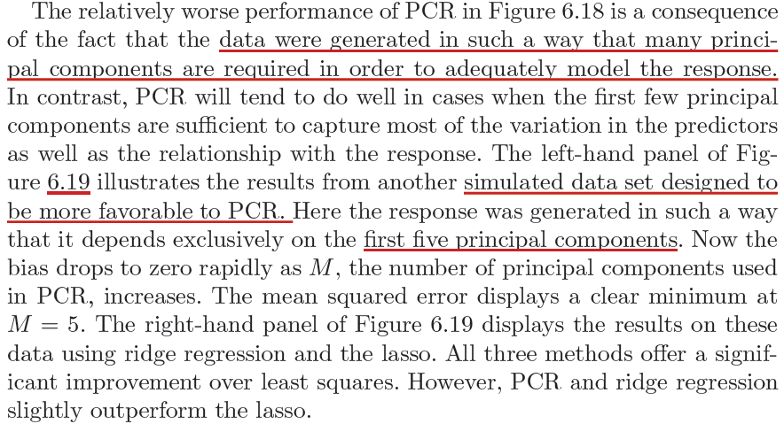
Principal Component Regression (PCR)

Slide 29
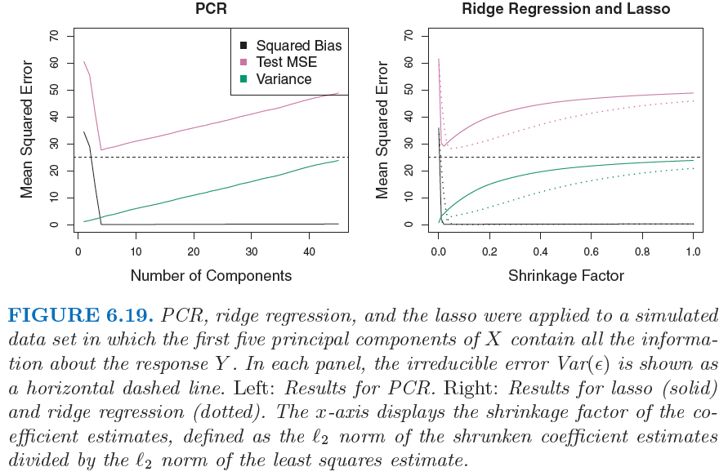
Principal Component Regression (PCR)

Slide 30
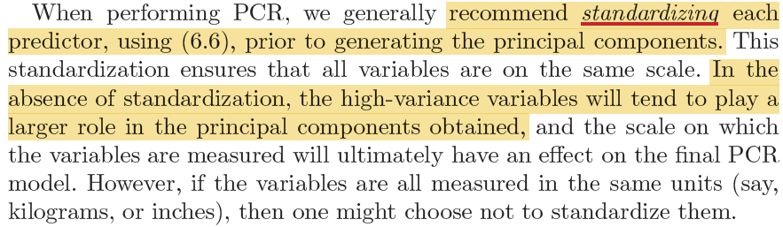
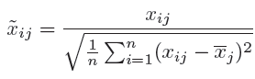
PCR, Some Additional Key Points
Notes:
End session 1

Slide 31
Partial Least Squares (PLS)
Notes:
Begin session 2

Slide 32
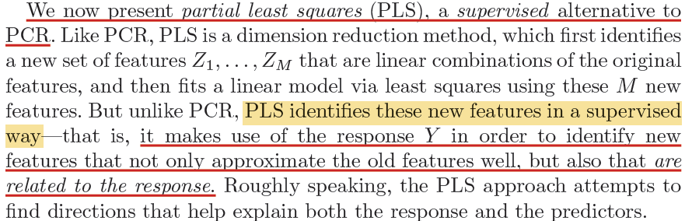
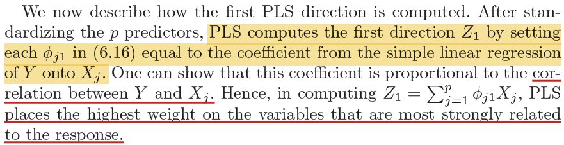
Partial Least Squares

Slide 33
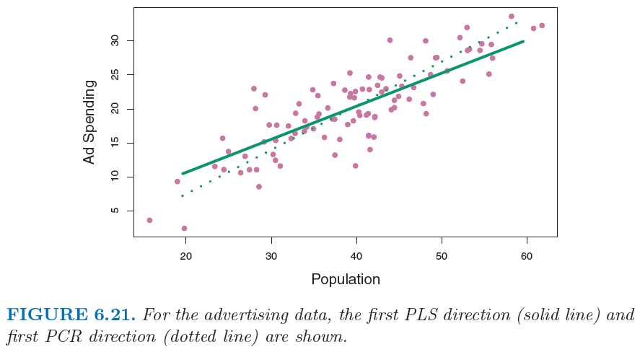
Partial Least Squares

Slide 34
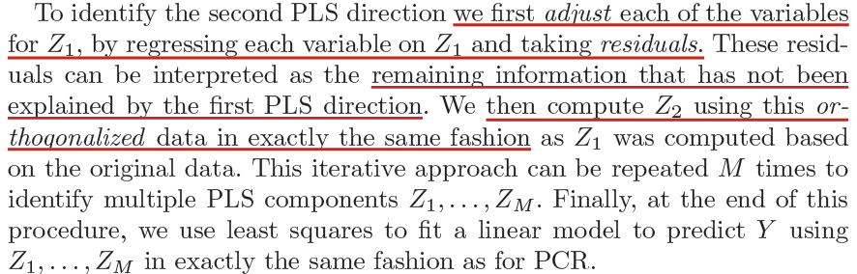
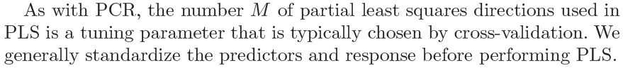
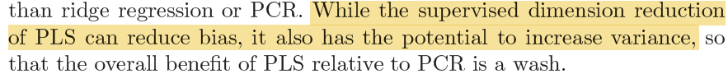
Partial Least Squares
Notes:
Adjust ‘each of the variables’ means adjusting the response as well as each of the predictor variables.
The procedure extends iteratively in a natural way to give components Z2, . . . , Zp, where each component is determined from the residuals of regressions on the preceding component, with residual variability in Y being related to residual information in the X's.
For more details, see: “An lnterpretation of Partial Least Squares”, by Paul H. GARTHWAITE. Available at:
http://avesbiodiv.mncn.csic.es/estadistica/pls2.pdf

Slide 35
Considerations in High Dimensions

Slide 36
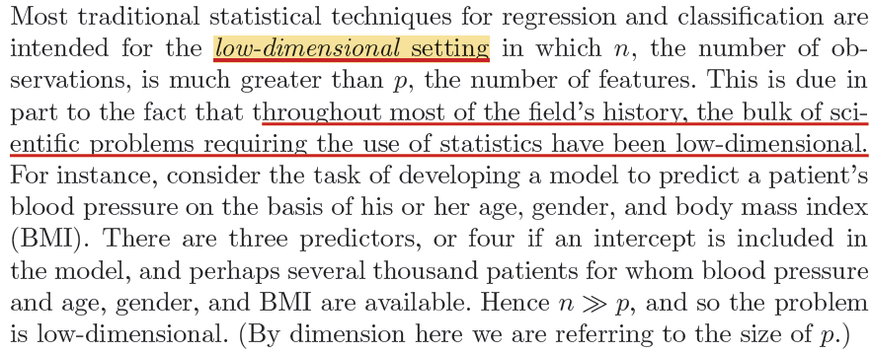
High-Dimensional Data

Slide 37
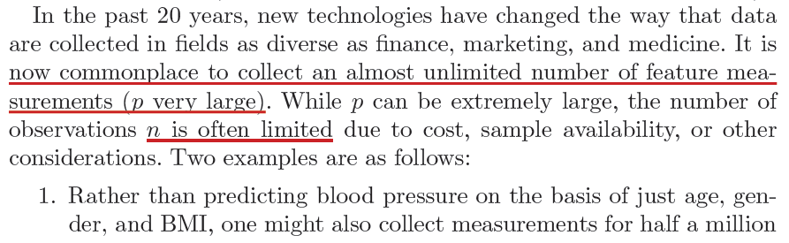
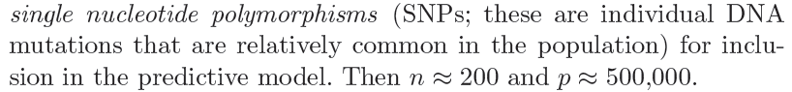
High-Dimensional Data

Slide 38
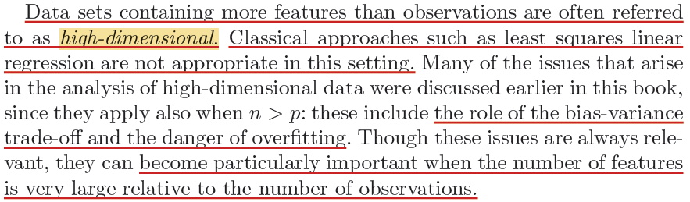
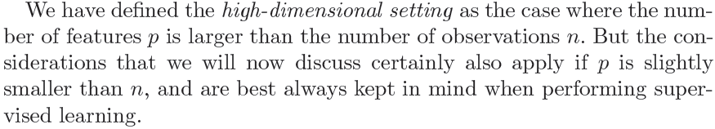
High-Dimensional Data

Slide 39
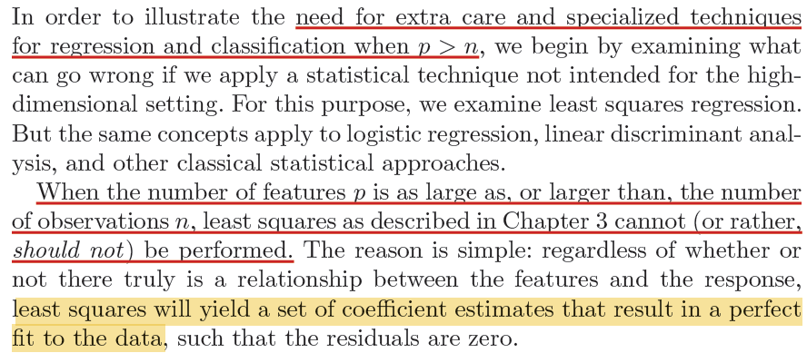
What Goes Wrong in High Dimensions?

Slide 40
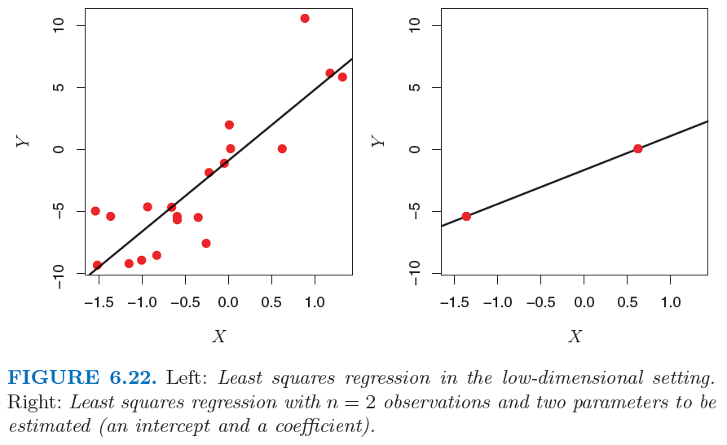
High-Dimensional Data

Slide 41

High-Dimensional Data

Slide 42


High-Dimensional Data

Slide 43

High-Dimensional Data

Slide 44


Regression in High Dimensions

Slide 45

High-Dimensional Data

Slide 46

High-Dimensional Data

Slide 47

Curse of High Dimensionality
So what do you think of new technologies that enable the measurement of thousands or millions of features?

Slide 48

Interpreting Results in High Dimensions

Slide 49


Interpreting Results in High Dimensions
Notes:
End session 2

Slide 50

End of Lecture #9
Source: http://yaroslavvb.blogspot.com/

